Slide 1
IMAGE RECOGNITON USING IBM CLOUD VISUAL RECOGNITION
SUBMITTED BY
MANIBHARATHI M(710021106018)
Anna university regional campus Coimbatore

Slide 2
CONTENTS
APPLICATIONS OF IMAGE RECOGNITION
WEATHER CLASSIFICATION
REAL TIME USE CASES
1.Meteorologist
2.Traveler
3.Smart Home Company
PROJECT DEVELOPMENT AND DEPLOYMENT

Slide 3
APPLICATIONS OF IMAGE RECOGNITION
Using image recognition, we can recognize objects, scenes, and faces. With deep learning capabilities, an ML model can be trained to recognize custom objects and even perform visual search.
Its applications are,
Weather classification
Animal classification
Face recognition
Cancer detection

Slide 4
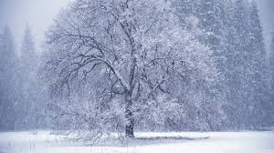
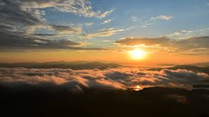
WEATHER CLASSIFICATION
Weather classification makes it possible to gather weather information simultaneously without human assistance and satellite assistance.
Thus we can employ deep learning techniques to detect images.
Rainy SUNRISE

Slide 5
REAL TIME USE CASES
Meteorologist
A Meteorologist monitor climates in multiple places. But it is not possible to gather the climate details of multiple places simultaneously.
So this model gives solution to the above problem by updating the weather of multiple places time to time.

Slide 6
REAL TIME USE CASES
Traveler:
A Traveler needs to know the climate in a particular place. But It is not possible to get an up to date information.
He/She may be worried about the unknown weather in a place and it spoils his/her travel plan.
Thus this model massively helps in solving a traveler's problem.

Slide 7
REAL TIME USE CASES
Smart Home Company:
A Smart Home Company needs to know the climate of a particular region. But It is not usually accurate and updated.
Thus this model massively helps in solving a smart home company’s problem.

Slide 8
PROJECT DEVELOPMENT AND DEPLOYMENT
Our Target here is to create an ML Model which is used to classify the images based on the deep learning technique called “Transfer Learning”.
Our first step is to collect datasets and follow some preprocessing techniques to structure the data.
The next step is to extract the useful features. This step is called feature extraction. In this project we can use VGG19 as a feature extractor.

Slide 9
PROJECT DEVELOPMENT AND DEPLOYMENT
In this model we use transfer learning
Transfer leaarning utilizes pre-trained CNN model(convolutional Neural Network)
Thus we can Fine-tune the pre-trained model on the weather dataset using transfer learning approaches.

Slide 10
THANK YOU!!

